Slide 1
Linking vital rates to climate drivers
And other things you never wanted to know about regressions

Slide 2
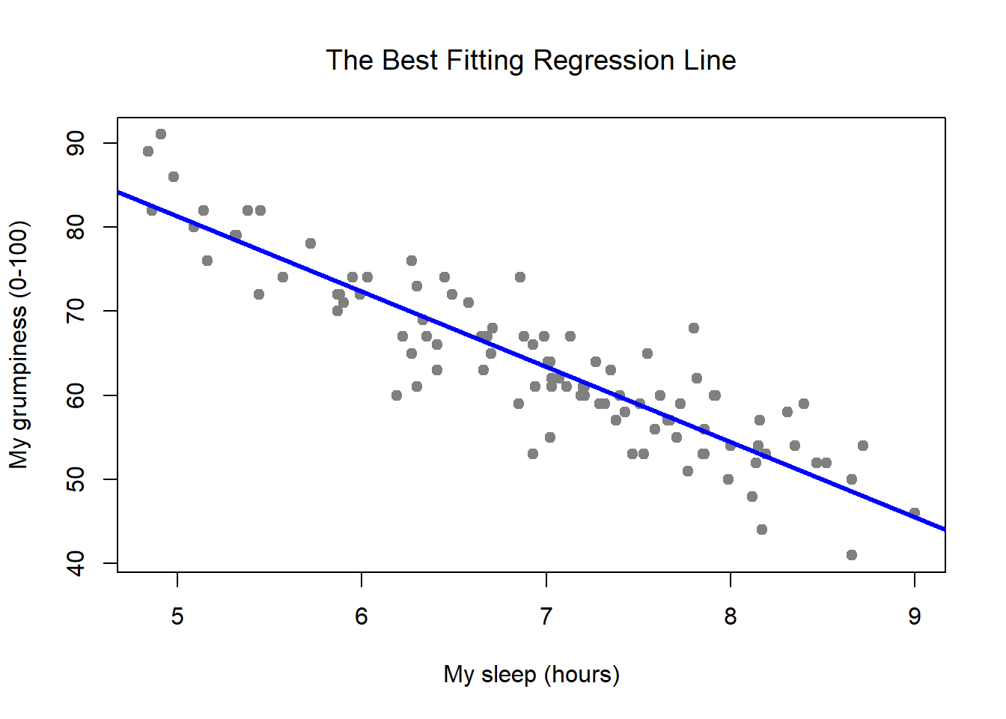

Linear regressions (LM)
Assumes a linear relationship between x and y
Variance in residuals (estimate errors) is assumed to be normal
$Y=β_{0}+X{∗β}_{1}$
https://bookdown.org/ekothe/navarro26/regression.html

Slide 3
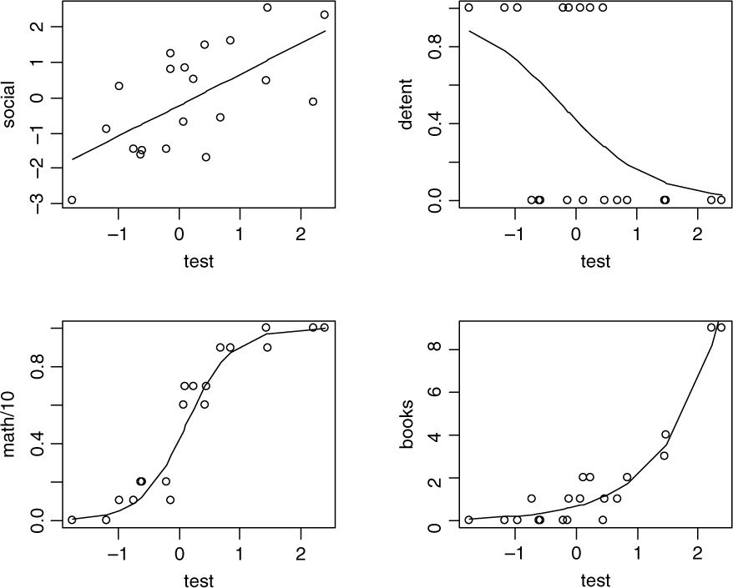
Generalized linear regressions (GLM)
Relationship between x and y does not have to be linear:
Binomial (Bernoulli)
Poisson
Gamma
Exponential
And many more
https://zhuanlan.zhihu.com/p/361449814

Slide 4
When are LM and GLM the same?

Slide 5
Fixed effects vs. Random effects
Fixed effects
Random effects
Change they cause to individual is constant:
Population – Treatment
Variable of interest for researcher
Estimated with full memory loss
Varies across individual
Year - individual
“Other” variable interesting for the population
Estimated with partial pooling

Slide 6
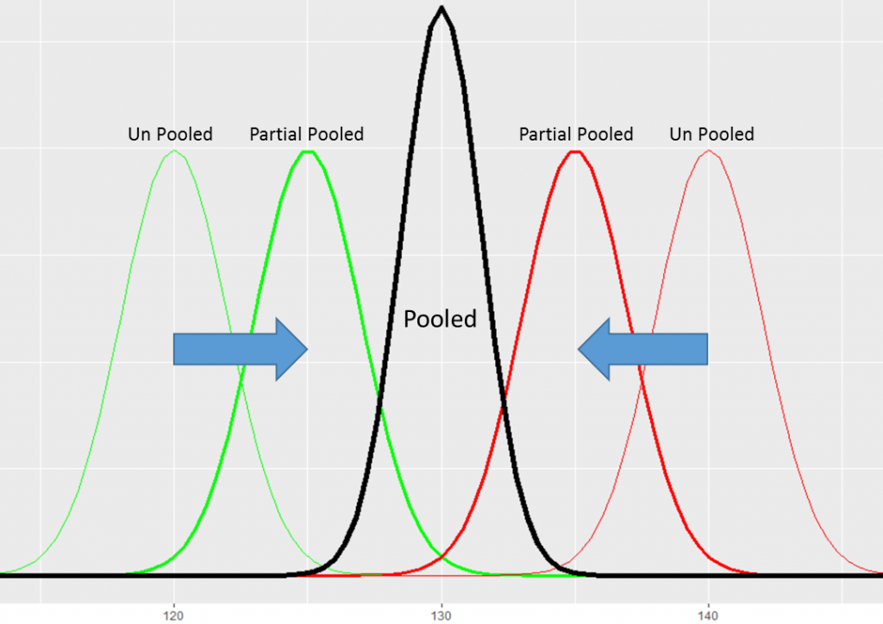
https://conductrics.com/prediction-pooling-and-shrinkage/

Slide 7

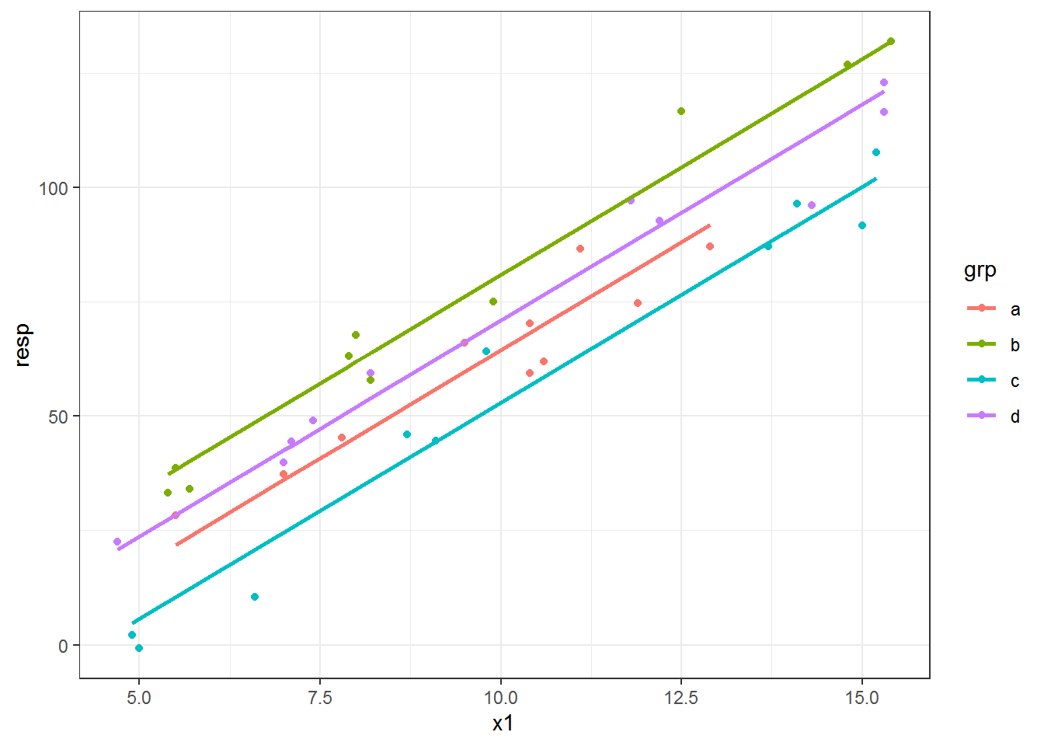
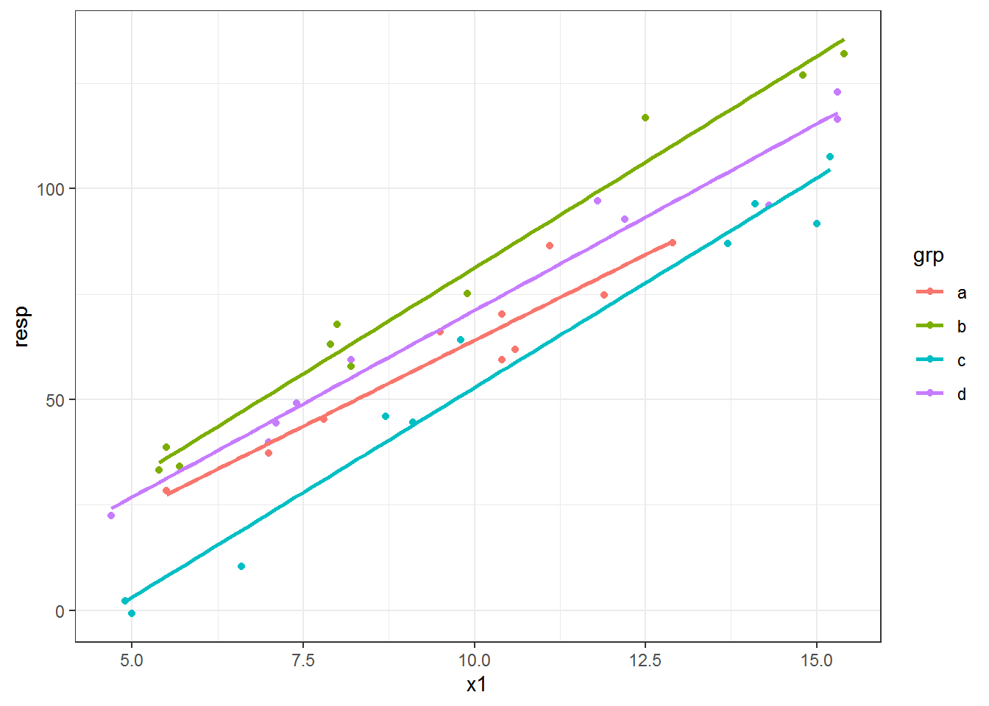
Examples from R
https://aosmith.rbind.io/2018/11/16/plot-fitted-lines/

Slide 8
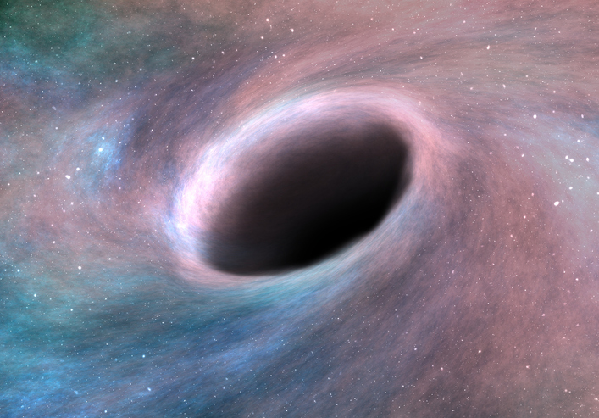
Non-linear regressions

Slide 9
Adding climate drivers
Fixed factors
Interactions with other variables
Size
Populations
How to pick climate driver candidates?

Slide 10
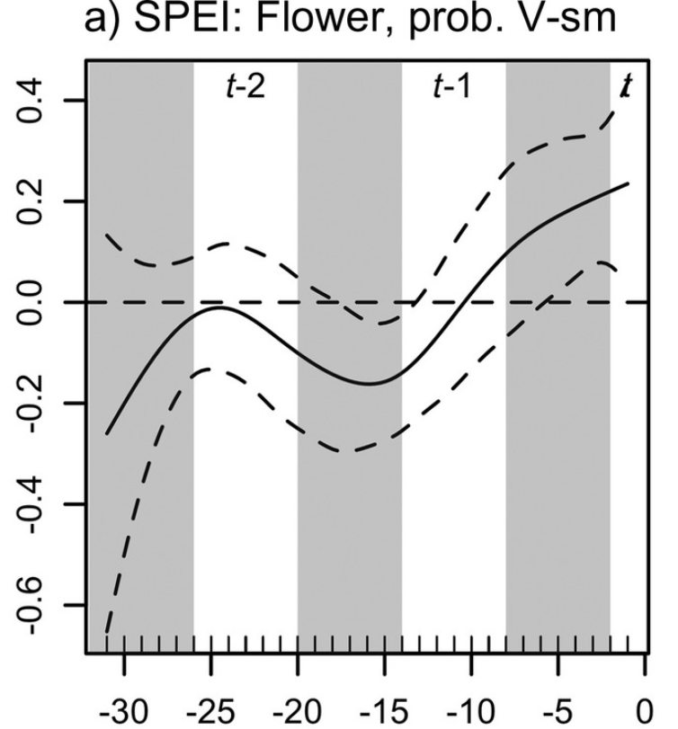
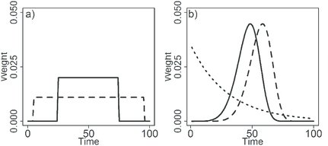
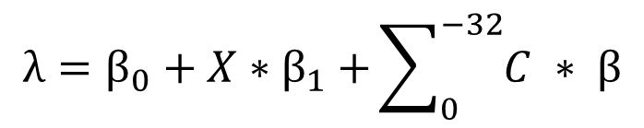

Selection methods
functional linear models = spline
$$λ=β_{0}+X{∗β}_{1}+\sum_{0}^{−32}{C ∗ β}$$
Linear models:
$$Y=β_{0}+X{∗β}_{1}+C{∗β}_{2}$$
Adapted from: Bailey & van de Pol, 2016
Adapted from: Tenhumberg et al., 2018

Slide 11
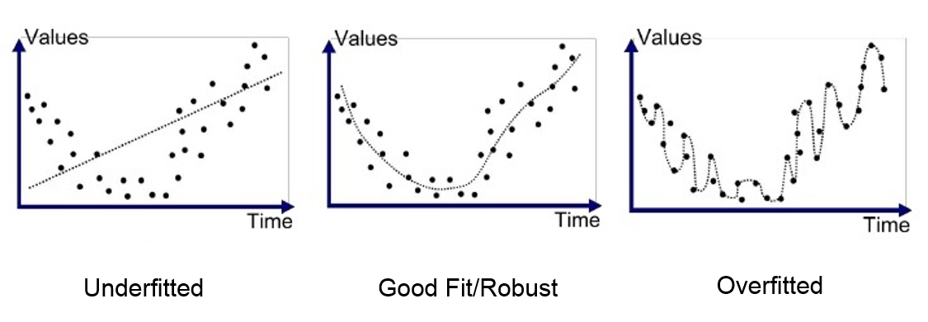
Why not just throw in everything?
Overfitting vs. underfitting
Within sample vs. outside sample
https://medium.com/greyatom

Slide 12
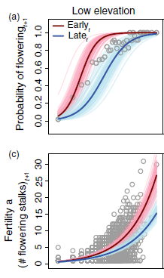
Even if you do everything right
It’s not an exact science
Uncertainties strengthen our research
Iler et al, 2019

